Slide 1
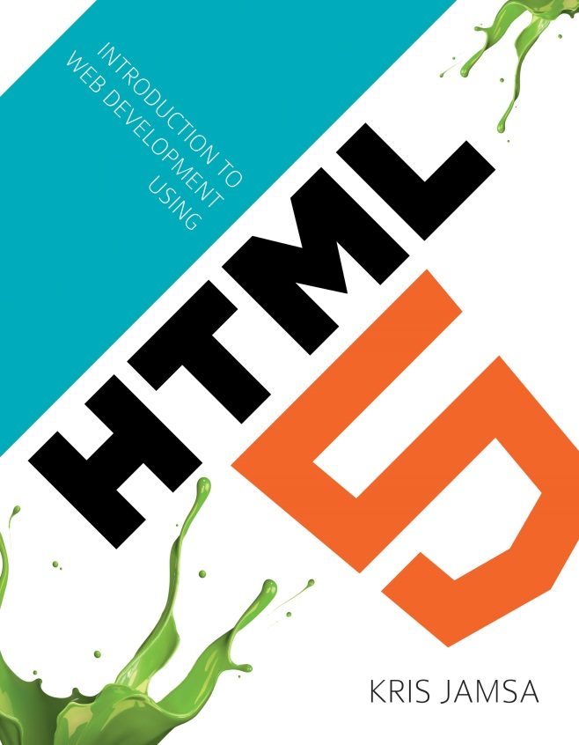
Chapter 7
Styling Content with Cascading Style Sheets

Slide 2
Learning Objectives
How to use the style attribute within an HTML tag to apply an inline style.
How to use the <style> and </style> tag pair to define embedded style definitions.
How to create an external style sheet file and use the <link> tag to include it within an HTML file.
When to use inline, embedded, and external style definitions.
Why the word “cascading” is used in the word cascading style sheets.

Slide 3
Inline styles
Developers refer to attribute settings that appear within an HTML tag as inline styles.
To specify inline styles, you place the style attribute within an HTML tag and within the style attribute, assign values to the formatting properties that you desire.
If you have a simple HTML page, using inline styles is fine.
As the number of pages in your Web site increases, the use of inline styles often leads to redundancy of effort and pages that are hard to modify.
<h1 style=“color:red”>This text is red</h1>

Slide 4
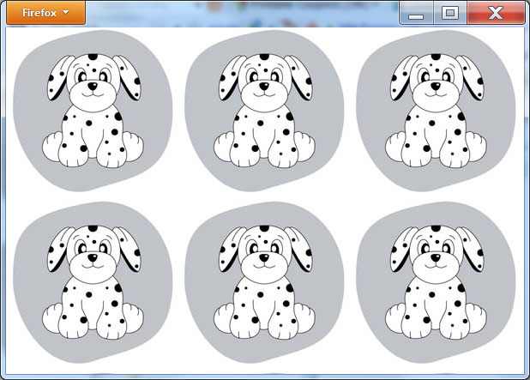
Setting a background image
<!DOCTYPE html> <body style="background-image: url('http://www.websitedevelopmentbook.com/chapter07/puppy.jpg')"> </body> </html>

Slide 5
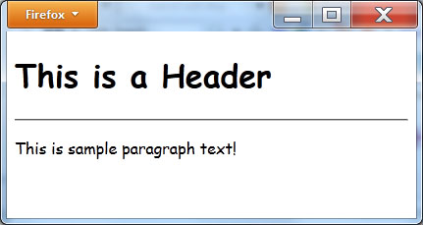
Sample inline style for fonts
<!DOCTYPE html> <body style="font-family:'Comic Sans MS'"> <h1>This is a Header</h1> <hr/> <p>This is sample paragraph text!</p> </body> </html>

Slide 6

Positioning images
<!DOCTYPE html> <body> <img src="http://www.websitedevelopmentbook.com/Chapter07/cigar.jpg" style="position:absolute; left:400px; top:300px; z-index:1;" /> <img src="http://www.websitedevelopmentbook.com/Chapter07/wine.jpg" style="position:absolute; z-index:0;" /> <img src="http://www.websitedevelopmentbook.com/Chapter07/pizza.jpg" style="position:absolute; left:500px; top:0px; z-index:2;" /> </body> </html>

Slide 7
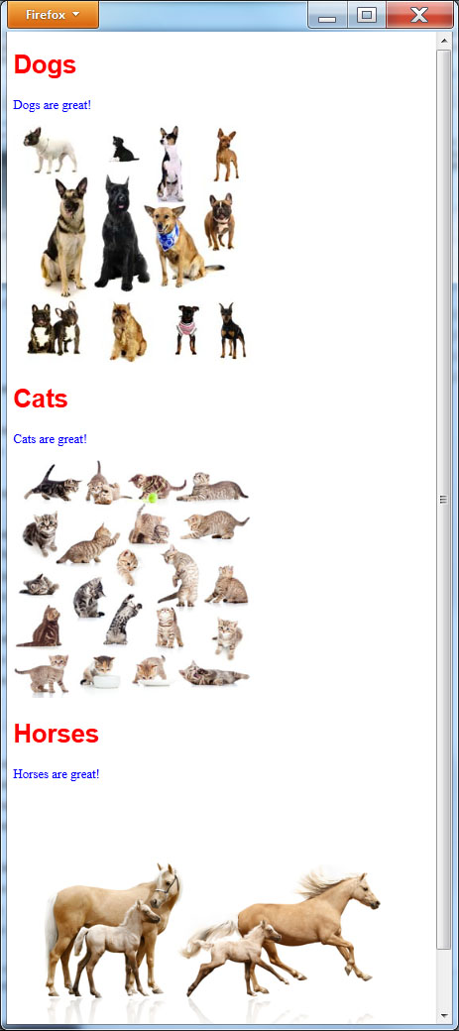
Styling various elements
<!DOCTYPE html> <body> <h1 style="color:red; font-family:arial;">Dogs</h1> <p style="color:blue; font-decoration:italic; text-align:left;">Dogs are great!</p> <img style="border:0;" src="http://www.websitedevelopmentbook.com/chapter07/dogs.jpg"/> <h1 style="color:red; font-family:arial;">Cats</h1> <p style="color:blue; font-decoration:italic; text-align:left;">Cats are great!</p> <img style="border:0;" src="http://www.websitedevelopmentbook.com/chapter07/cats.jpg"/> <h1 style="color:red; font-family:arial;">Horses</h1> <p style="color:blue; font-decoration:italic; text-align:left;">Horses are great!</p> <img style="border:0;" src="http://www.websitedevelopmentbook.com/chapter07/horses.jpg"/> </body> </html>

Slide 8
Embedded style definitions
An inline style is so named because it appears “inline” within an HTML tag. The inline style applies only to the tag within which it appears.
In contrast, an embedded style, which you will define using the <style> and </style> tag pairs, will, by default, apply to all occurrences of a tag.
To define an embedded style, you place the <style> and </style> tag pair inside the <head> and </head> tag pair at the top of your file.
<head> <style type="text/css"> h1 { color:blue; } </style> </head> <body>

Slide 9
Embedded styles
<!DOCTYPE html> <head> <style type="text/css"> h1 { color:red; font-decoration:italic; text-align:left; } p { color:blue; font-decoration:italic; text-align:left; } img { border:0; } </style> </head> <body> <h1>Dogs</h1> <p>Dogs are great!</p> <img src="http://www.websitedevelopmentbook.com/chapter07/dogs.jpg"/> <h1>Cats</h1> <p>Cats are great!</p> <img src="http://www.websitedevelopmentbook.com/chapter07/cats.jpg"/> <h1>Horses</h1> <p>Horses are great!</p> <img src="http://www.websitedevelopmentbook.com/chapter07/horses.jpg"/> </body> </html>

Slide 10
Inline styles override embedded
When you define style properties for an HTML element using embedded styles, you set the default format for each occurrence of the tag throughout your HTML file.
After you define a default style, there may be times when you want to use a unique format for a specific tag within your page.
In such cases, you can override the embedded style definition using an inline style.

Slide 11
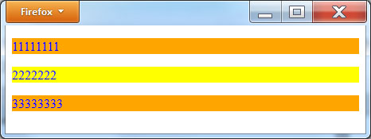
Overriding a style definition
<!DOCTYPE html> <head> <style type="text/css"> p { color:blue; background-color:orange; } </style> </head> <body> <p>11111111</p> <p style="background-color:yellow">2222222</p> <p>33333333</p> </body> </html>

Slide 12
External style sheets
Embedded styles let you control the format of HTML elements throughout your entire page. In this way, you can quickly apply or later change the entire look and feel of your page.
Most Web sites, however, consist of multiple pages. Admittedly, you could place the same embedded style definitions at the top of each page. However, do so requires repetitive work. Further, should you later decide to change an element’s appearance, you would again have to edit every page’s corresponding file—which is not only time consuming, but also error prone.
An external CSS style sheet lets you place all of your CSS style definitions within one file that you then reference from within each of your HTML page files. When a user views a page, the browser will download and apply the style definitions provided in the corresponding .CSS file. Should you later need to change a style, you simply edit the .CSS file and your changes will automatically apply to the pages that use the file.
To create an external style sheet file, you use a text editor, just like you would to create an HTML file. Within the external style sheet file, you do not use the <style> and </style> tag pair to define your style properties.

Slide 13
Sample external style sheet (Sitestyles.css)
h1 { color:red; background-color:yellow; font-family:'Comic Sans MS'; } p { color:blue; background-color:orange; font-family:Arial; }

Slide 14
Linking in the style sheet
<head> <link rel="stylesheet" type="text/css" href="SiteStyle.css" /> </head>

Slide 15
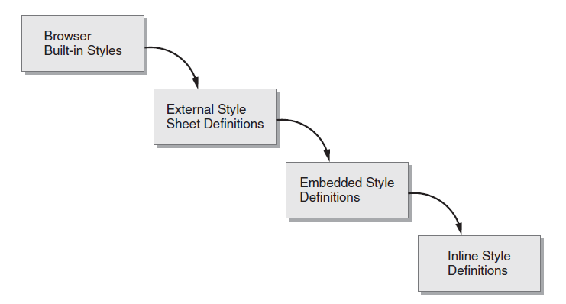
Understanding the “Cascading” in Cascading Style Sheets

Slide 16
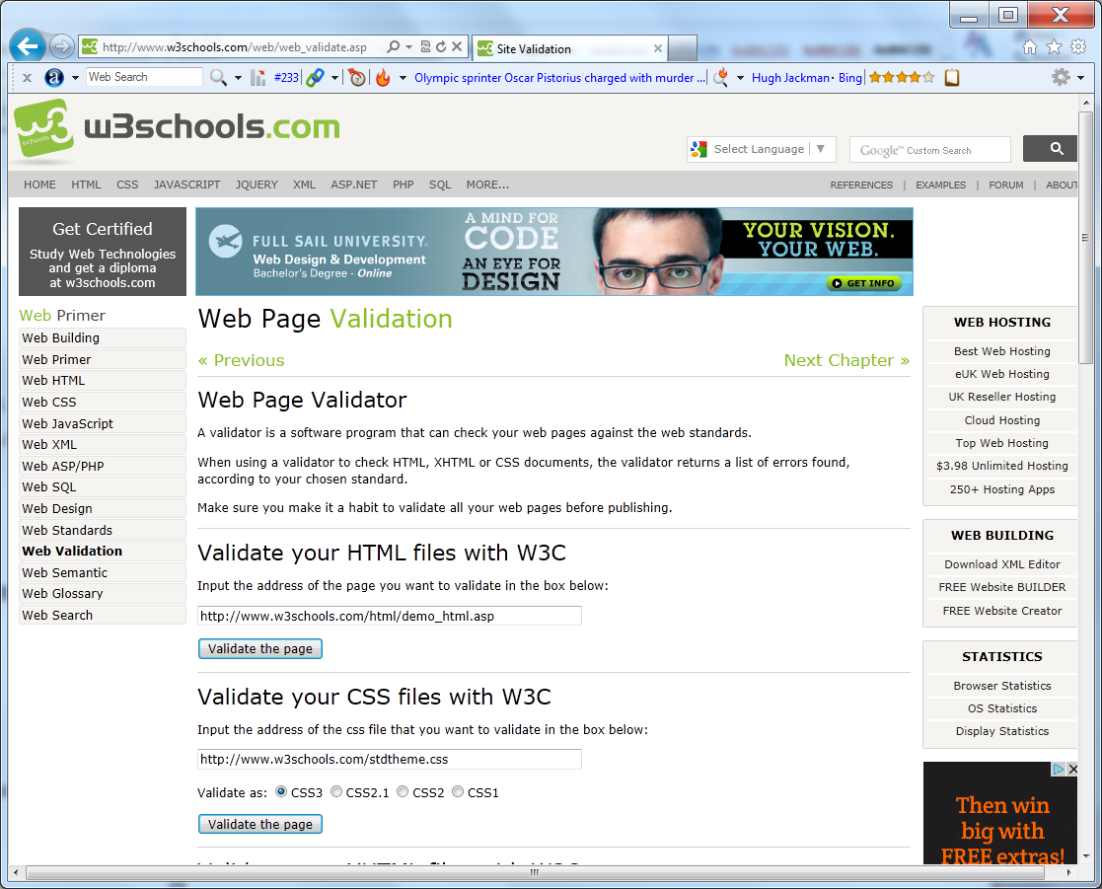
Real world: validating css styles

Slide 17
summary
Across the Web, developers make extensive use of cascading style sheets, CSS, to format elements within a Web page.
By default, if a Web developer does not specify CSS attributes for an HTML element, a browser will use its own default, built-in, formatting.
To specify formatting using CSS, developers can use inline styles, embedded styles, and external styles. An inline style appears within an HTML element tag and affects only that occurrence of the element.
An embedded style, in contrast, affects all of the corresponding tags within an HTML file.
And finally, an external style sheet file defines styles that a developer can easily apply to multiple pages within a Web site. Using external style sheets, the developer can apply consistent styles throughout a site and easily and effectively add or modify styles.

